Slide 1

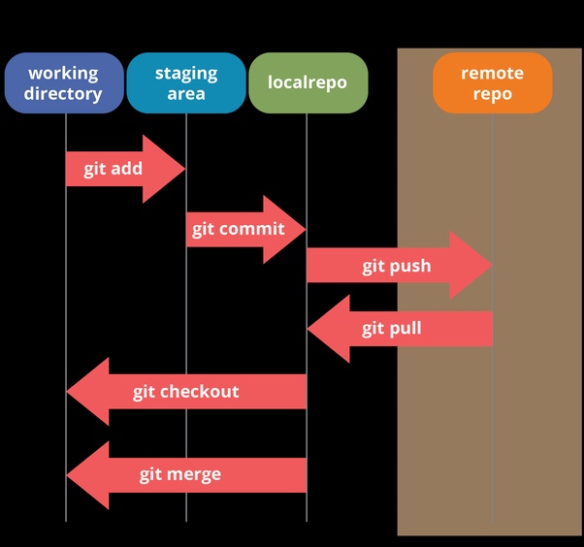
Part 2:
Series: Imaging Science Tools
Git for Science – Git, github, gitlab, TortoiseGit
Prof. Dr. Moritz Zaiss
Max-Planck Institute for biological cybernetics, Tübingen
University Clinic Erlangen, Friedrich-Alexander University (FAU) Erlangen-Nürnberg
moritz.zaiss@fau.de
Outline:
git repositories
clone, commit, pull, push, diff
Merge requests and issues
https://youtu.be/NG0MBnbDGY8

Slide 2
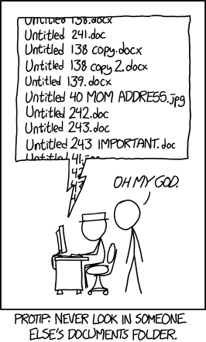
What is git?
git was originally authored by Linus Torvalds to maintain the Linux kernel
git is a free and open source versioning and repository tool mostly for code and text based files.
Losing your work is very hard
Tracking your changes is very easy
Collaborating on projects is much easier
​​​​​​​MRI_eval_code_FINAL.m
​​​​​​​MRI_eval_code_FINAL last version.m
​​​​​​​MRI_eval_code_Final FINAL last version.m
MRI_eval_code_Final FINAL best version.m
36bbed3e
​​​​​​​MRI_eval_code.m

Slide 3
What is GIT?
C:\labnotebook\codes\Z-cw
https://github.com/cest-sources/Z-cw
MRI_eval_code.m
MRI_eval_code.m
git clone
One file with
tracked version
Published and approved
version
git diff

Slide 4
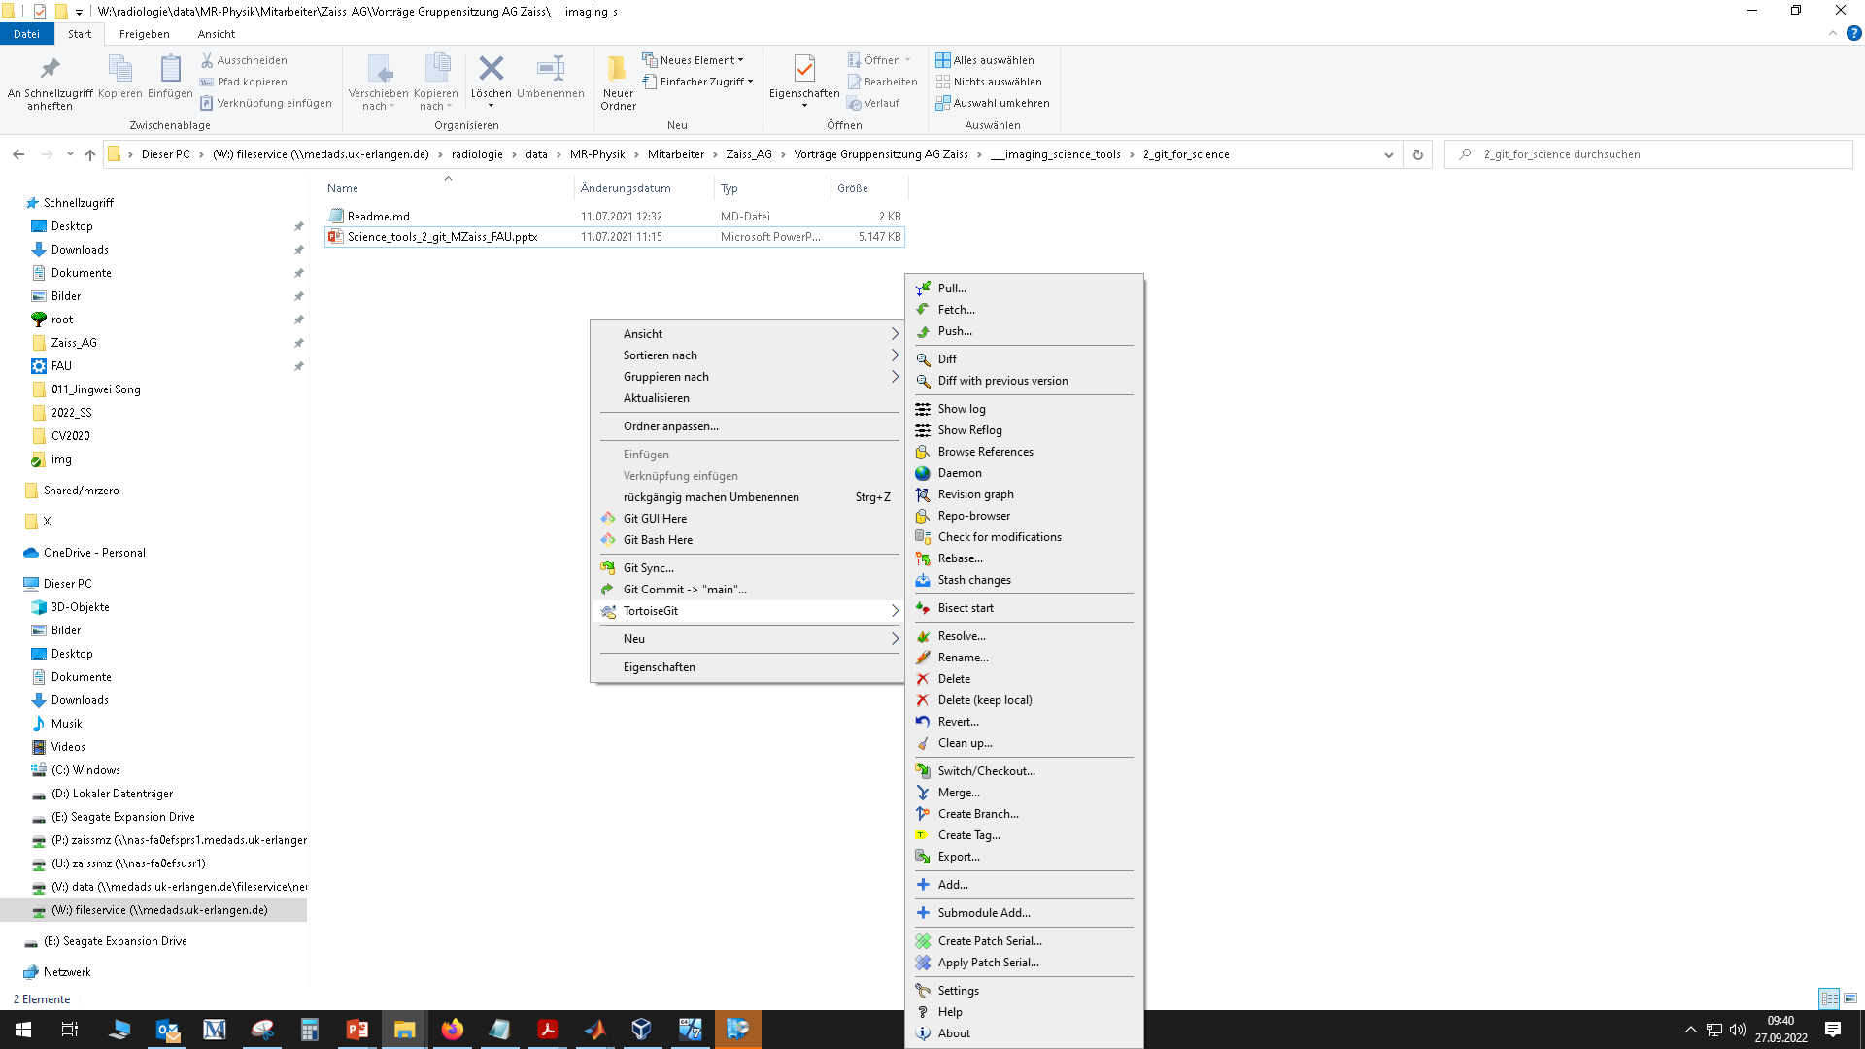
Git commands
Unix – Shell
Windows – TortoiseGit
git clone
git add
git commit
git pull
git push

Slide 5
Hands on!
already installed: Matlab, git (git-scm.com), TortoiseGit (tortoisegit.org)
C:\labnotebook\codes\Z-cw
https://github.com/cest-sources/Z-cw
git clone
Live demo
https://youtu.be/NG0MBnbDGY8

Slide 6
Hands on!
C:\labnotebook\codes\Z-cw
https://github.com/cest-sources/Z-cw
git clone
git diff

Slide 7
Branches and Merge requests
The main branch can be protected, so you cannot push
Push to another branch, e.g. dev_mz
And make a merge request.
Another person can now review your changes and merge the branch to the main branch.

Slide 8
Issues
For any problem or feature request you can create an issue
There things can be discussed, todo list be made and people assigned

Slide 9
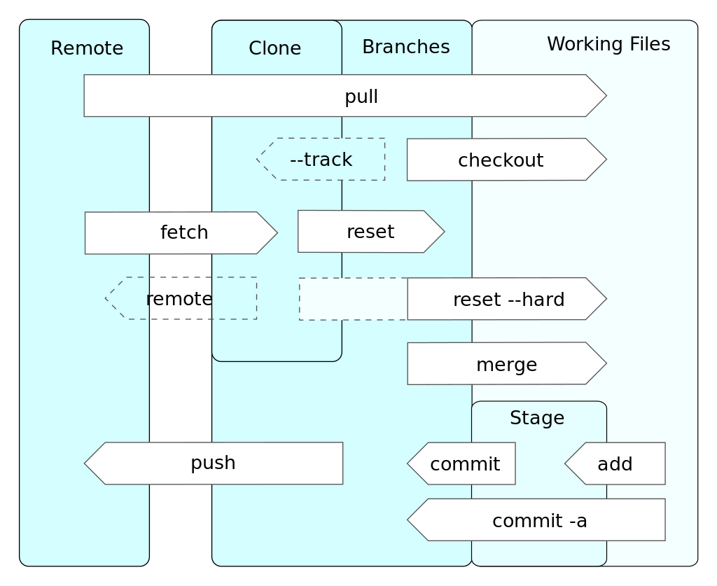
more commands

Slide 10
Summary
Git provides versioning of code repositories. You can now..
.. track changes you made
.. track and use changes others made
.. never loose code anymore
.. collaborate in a structured way
https://github.com/cest-sources/imaging_science_tools
moritz.zaiss@fau.de

